Slide 1

Course Registration System
GROUP 8
Notes:
Hi Everyone,
Good Morning
Before we start with the presentation today, I would like to share a small recital.
We have been a part of Publicis Sapient for almost 3months now, and there is this fact that everyone of us would agree upon.
We all started as fresh graduates, underwent 5weeks or so of rigorous training followed by what…5 weeks now of a Hands On project, and what has transpired in these days is a fact that we all are really proud of. A transformation from someone who could code, to someone who can not only code, but add value to everything he does.
So have we succeeded at becoming a Product engineer?
Hi, I am Rajat, a small part of our big team here.
I am here with my colleagues Aman and Chinmay and we are here to give you a walkthrough of our Transformation, our Journey and the project we have been working for sometime now.

Slide 2
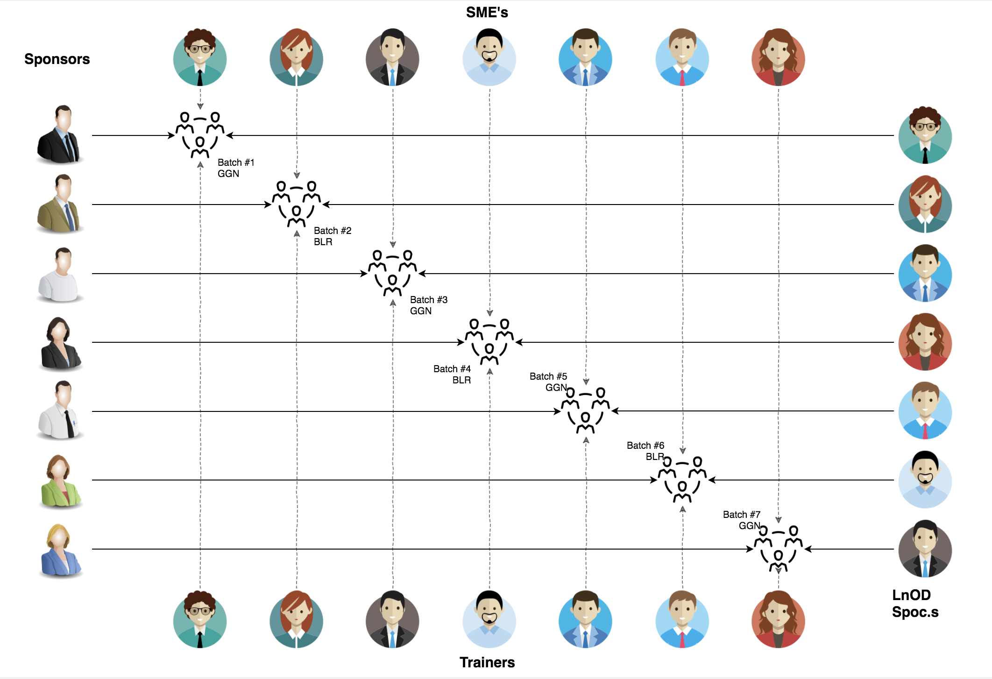
Stakeholders
Sponsors
Flipkart
Trainers
Amit Balyan
3. SME’s
Shree (Order Trainings)
Heena Bansal

Slide 3

Agenda
01
Our Journey
02
Our Team
03
Team Structure
04
Problem Statement
05
Engineering Practices
06
Tech Stack
07
Development
08
Challenges & Learnings
09
Demo
10
Questions
Notes:
Time – 1 min

Slide 4

Our Journey
Notes:
Time - 2 mins

Slide 5
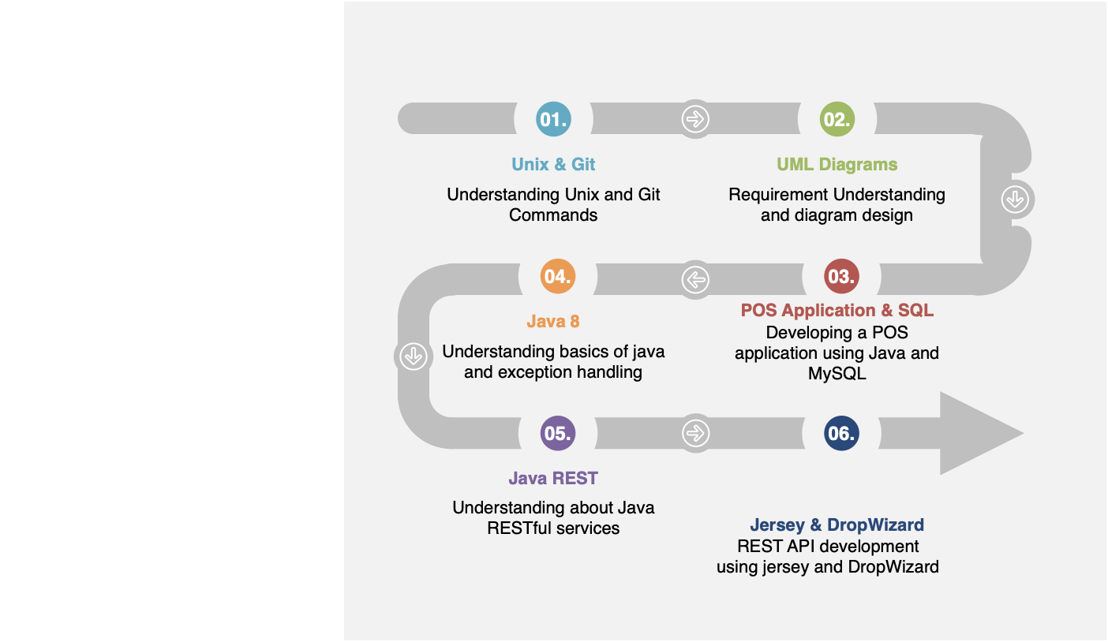
DAY 1-5
DAY 6-10
DAY 11
Notes:
Presented by Anmol Gupta
On Day 1 ,we installed the required softwares….IntelliJ,Git,Java.
On Day 2,we started tutorial on basic Unix and Git commands-1 assignment to create a Git repo and teams were created
On Day 3,We met our team and studied SDLC(Software Development Life Cycle) and the UML(Unified Modelling Language) diagrams.
SDLC->Waterfall Model,Iterative Model,Spiral Model,Agli

Slide 6
Our next starts
NOW
Notes:
Time – 1 min
Swati

Slide 7
Demo
Testing
Process
5
project Demo
Tools
4
Testing on Console, REST client such as Postman
Comprehend
3
Architecture Design and Development
2
Decide the Technology stack for console and REST API development
1
Understanding Project Requirements and Goals

Slide 8
1.5 WEEKS OF TRAINING + PROJECT DEMO
11 DAYS
88 HOURS
5280 MINUTES
316800 SECONDS
LIMITLESS KNOWLEDGE

Slide 9

Our Team
Notes:
Time – 2 mins

Slide 10
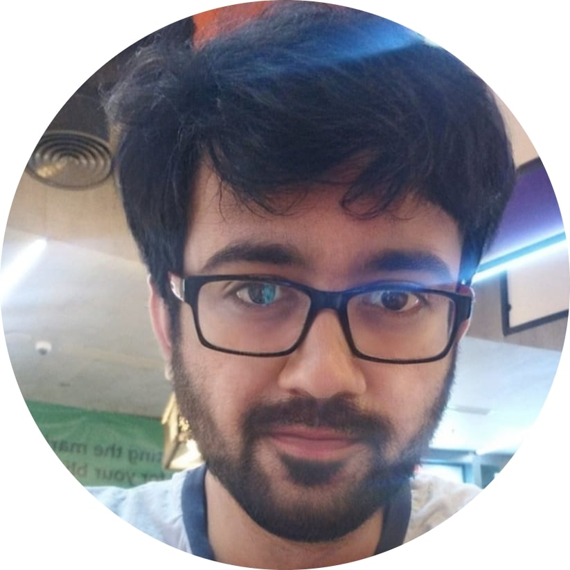
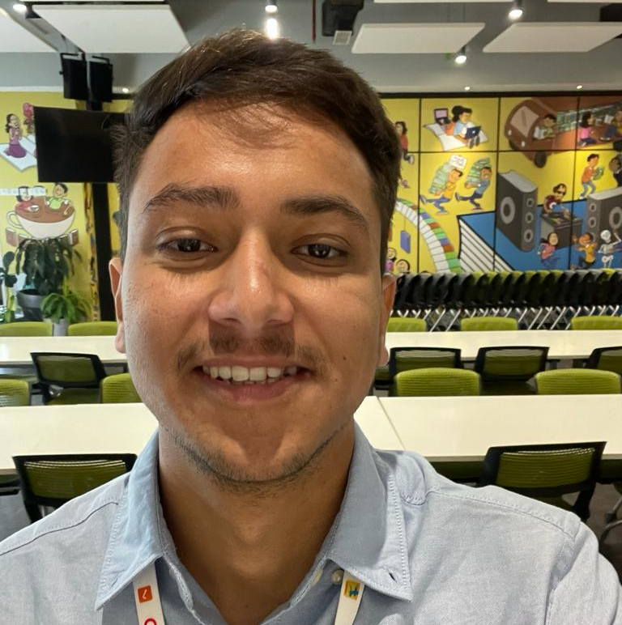
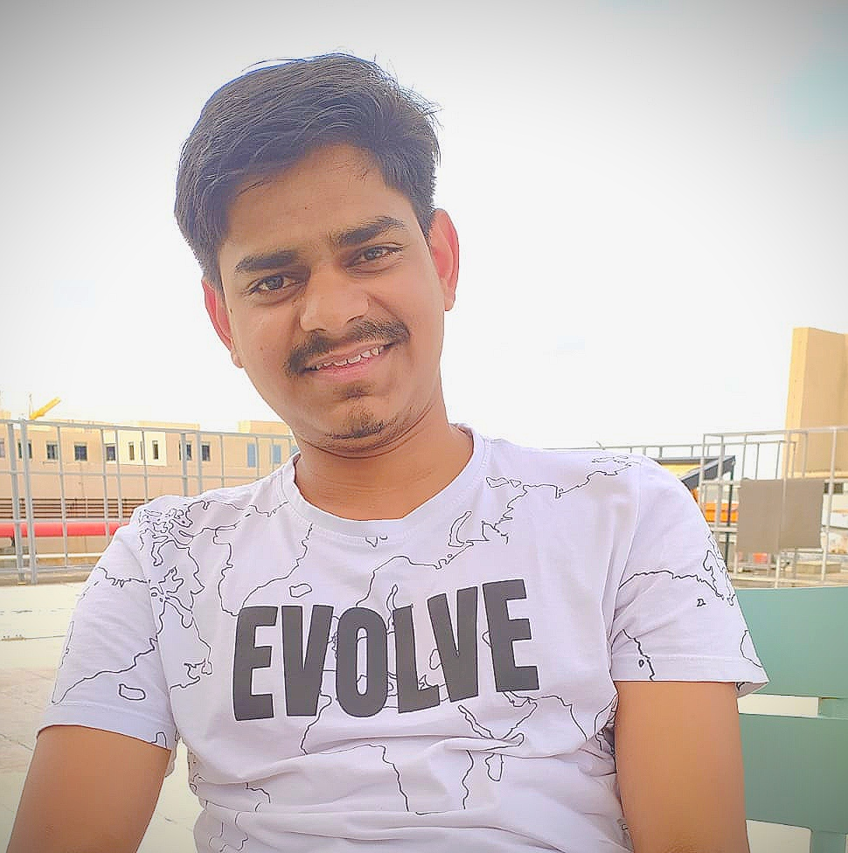
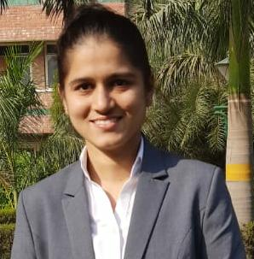
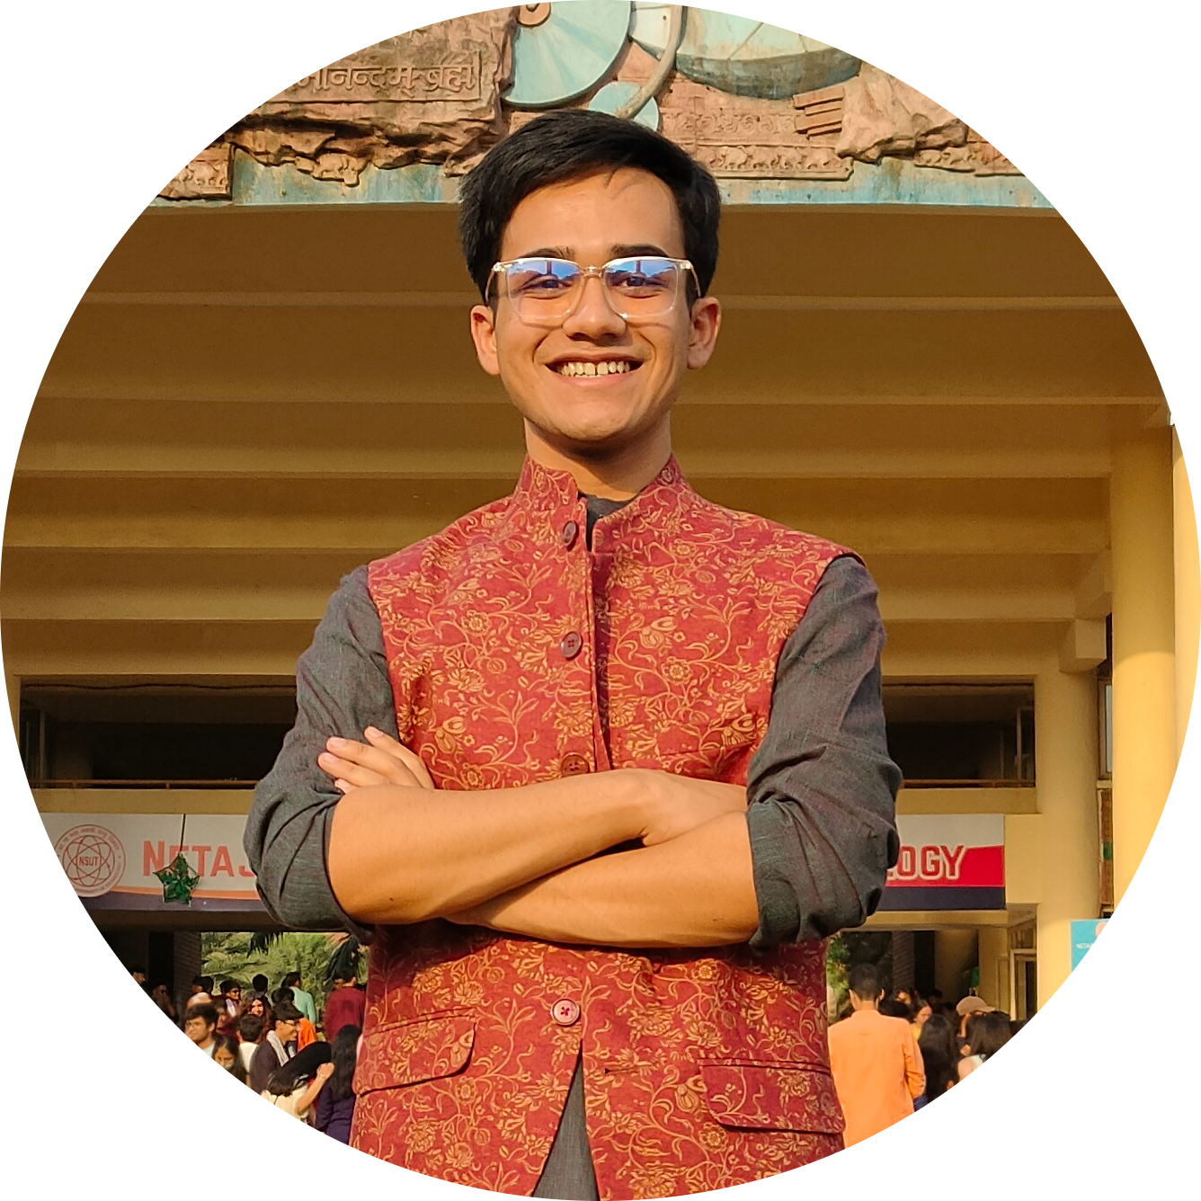
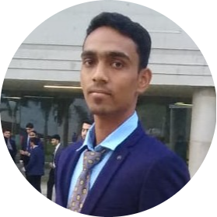
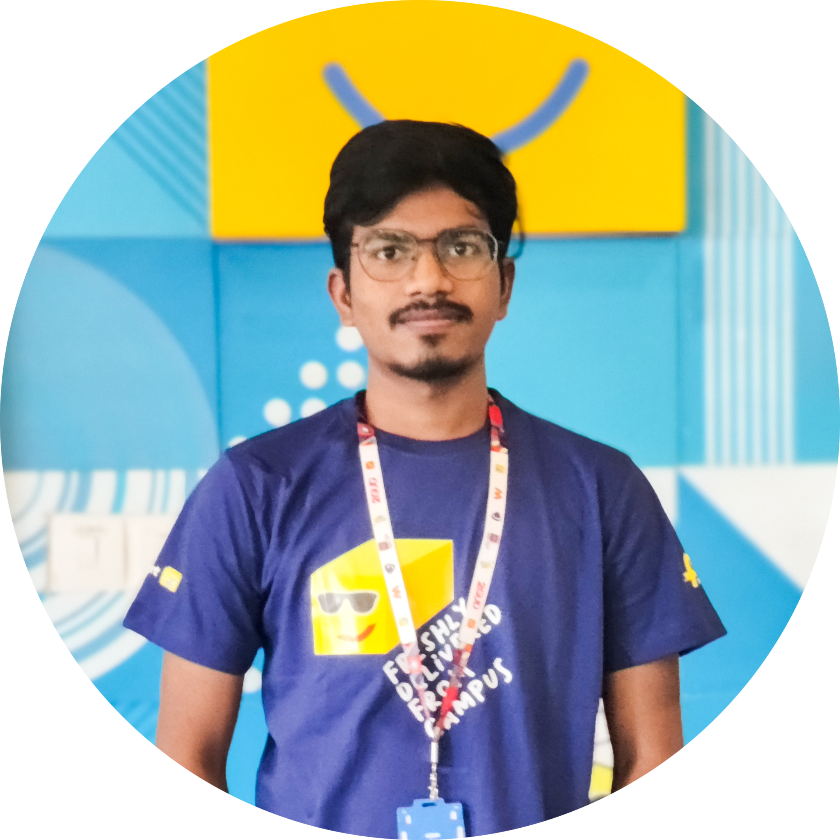
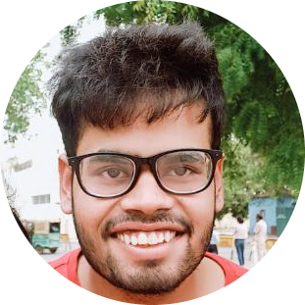
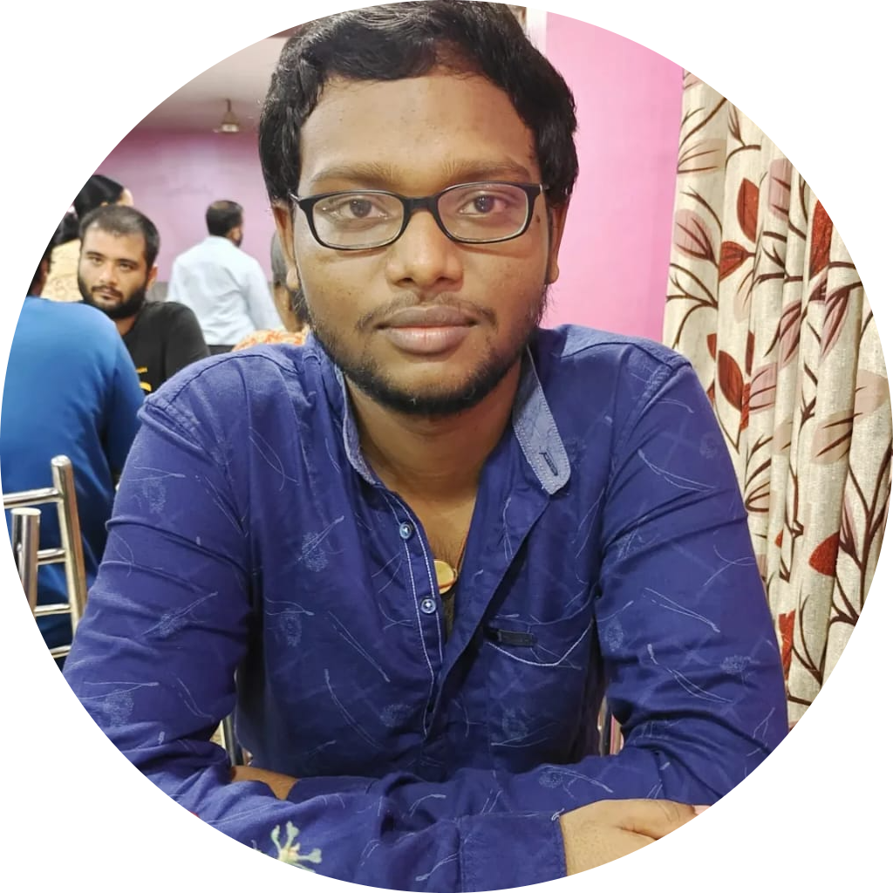
Akshat Gupta
Mohan Joshi
Paras Joshi
Avani Singh
Srijan Sarkar
Ritesh Parmar
Karan Karhale
Anmol Gupta
Rupesh Kumar Pallai

Slide 11

TEAM STRUCTURE
Notes:
Well, as it happens in a good team, we divided the work quite uniformly amongst ourselves giving us the best chance to not only learn and gain the desired knowledge but also, to be able to finish the project and the presentation within the deadline.

Slide 12

Project Goals
Notes:
Time – 3 mins

Slide 13
Problem Statement
Entities involved are: Student, Professor, Admin
Students should be able to Register for courses and view an electronic report card at the end of the semester.
Professors access the system to choose and teach courses, record grades.
The Admin should be able to Approve a Student, Register a Professor, add/remove course from course catalog.
The System should allow students to select courses. Students can add/drop courses.
Course offerings should have a maximum of ten students and a minimum of three students.
After the registration, the system sends information to the billing system so that the student can be billed for the semester.
Notes:
User satisfaction and brand value
Problem Statement

Slide 14




Our Vision
1
2
To develop a POS application and REST API for Course Registration System using using JAVA/REST tools and technologies, where a professor as well as a student can view courses and enroll in some of the courses.
Quality
Security
3
4
Interactivity
Speed
Notes:
User satisfaction and brand value
Problem Statement

Slide 15

Engineering Practices
Notes:
Time – 5 mins

Slide 16
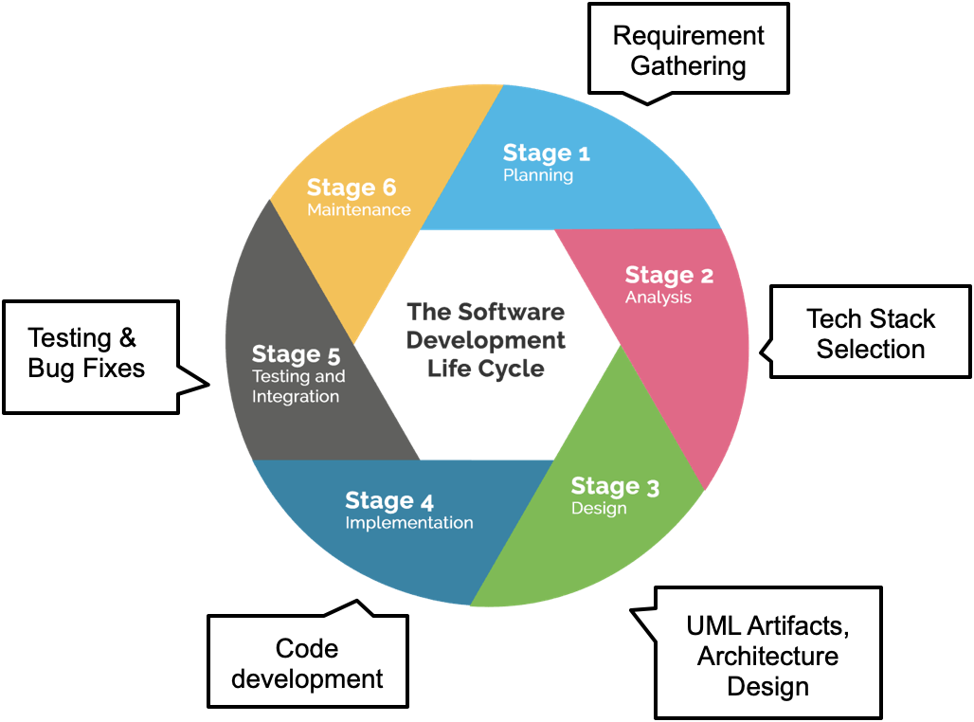
Notes:
Implementation ->

Slide 17

Tech Stack
Notes:
Time – 2 mins

Slide 18














Designing
Backend
Testing
Data
SCM
UML
Core Language
Tools
SQL Database
Code Collaboration
Framework
Application Server
Notes:
Time – 1 min
Java
Maven
DropWizard
MySQL
Jersey
GitHub
Postman / ARC (Check it)
StarUML / Dia / Lucid Charts
List
Design
Backend
Testing
Tools

Slide 19

Challenges & Learnings
Notes:
CHALLENGES
MAVEN SETUP
REST API TESTING
MERGE CONFLICTS
LEARNINGS
SDLC CONCEPTS
MVC ARCHITECTURE
TESTING APIS

Slide 20

CHALLENGES
Understanding the problem statement and initial implementation using Use Case, activity, sequence and class diagram.
Installing software on multiple environments.
Git merge conflicts.
Resolving jar and version dependencies.
Database integration challenges.
Working Remotely

Slide 21

LEARNINGS
Familiarization with Unix Commands.
Getting hang of the basic Git commands.
Software Development Life Cycle.
Knowledge and Implementation of Activity, Sequence and Use Case Diagram.
Java 8 features.
Integration of REST Services with Java code using Tomcat and Jersey.
Dropwizard Integration and Advantages.
Usage of Postman for testing APIs.
Javadoc Generation & basic Application Monitoring.

Slide 22

Architecture Design
Notes:
Time – 1 min

Slide 23

POS Application
Java Main Client
Business Code
Database Code
HTTP Request
HTTP Response
Notes:
n-tier

Slide 24

UML Diagrams
Notes:
Time – 3 mins

Slide 25
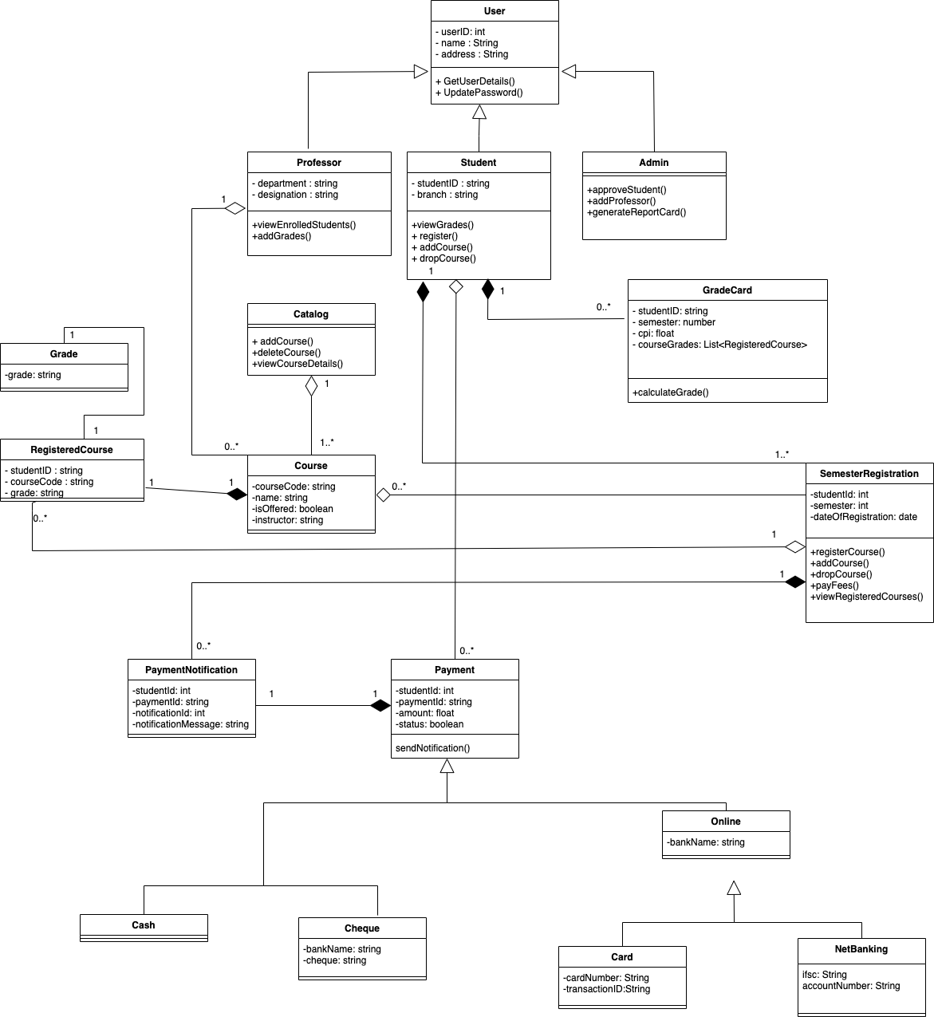
CLASS DIAGRAM

Slide 26
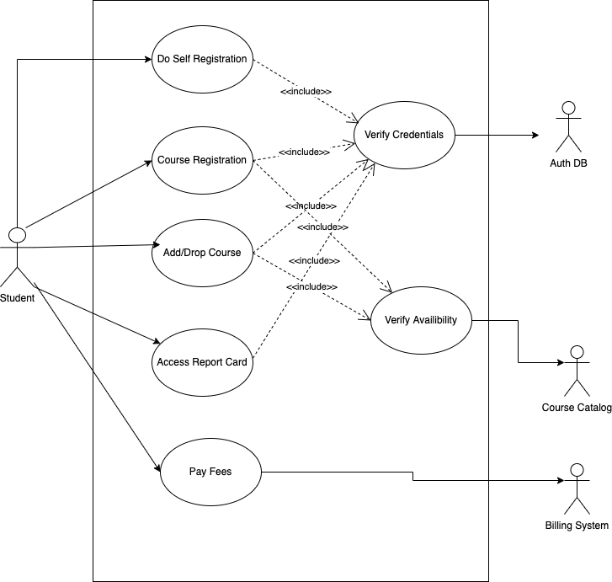
USE CASE DIAGRAM
(STUDENT)

Slide 27
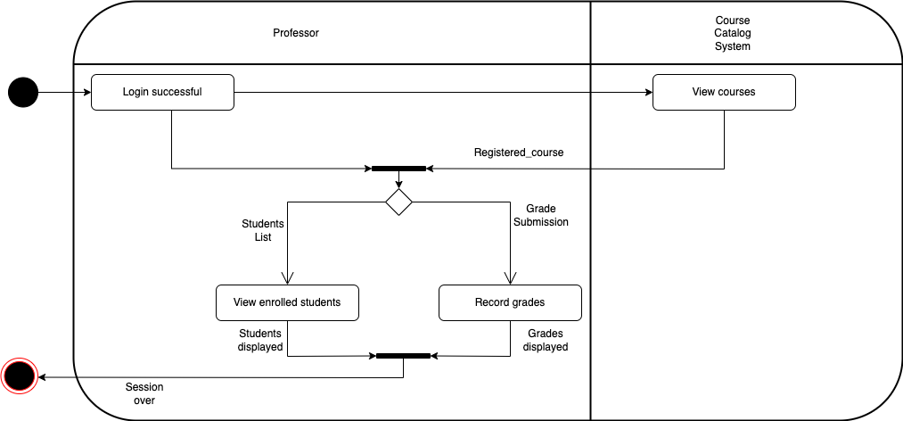
ACTIVITY DIAGRAM(PROFESSOR)

Slide 28
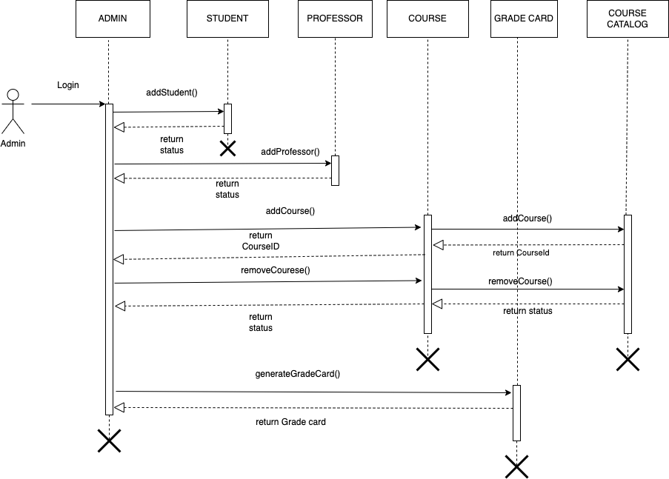
SEQUENCE DIAGRAM(ADMIN)

Slide 29
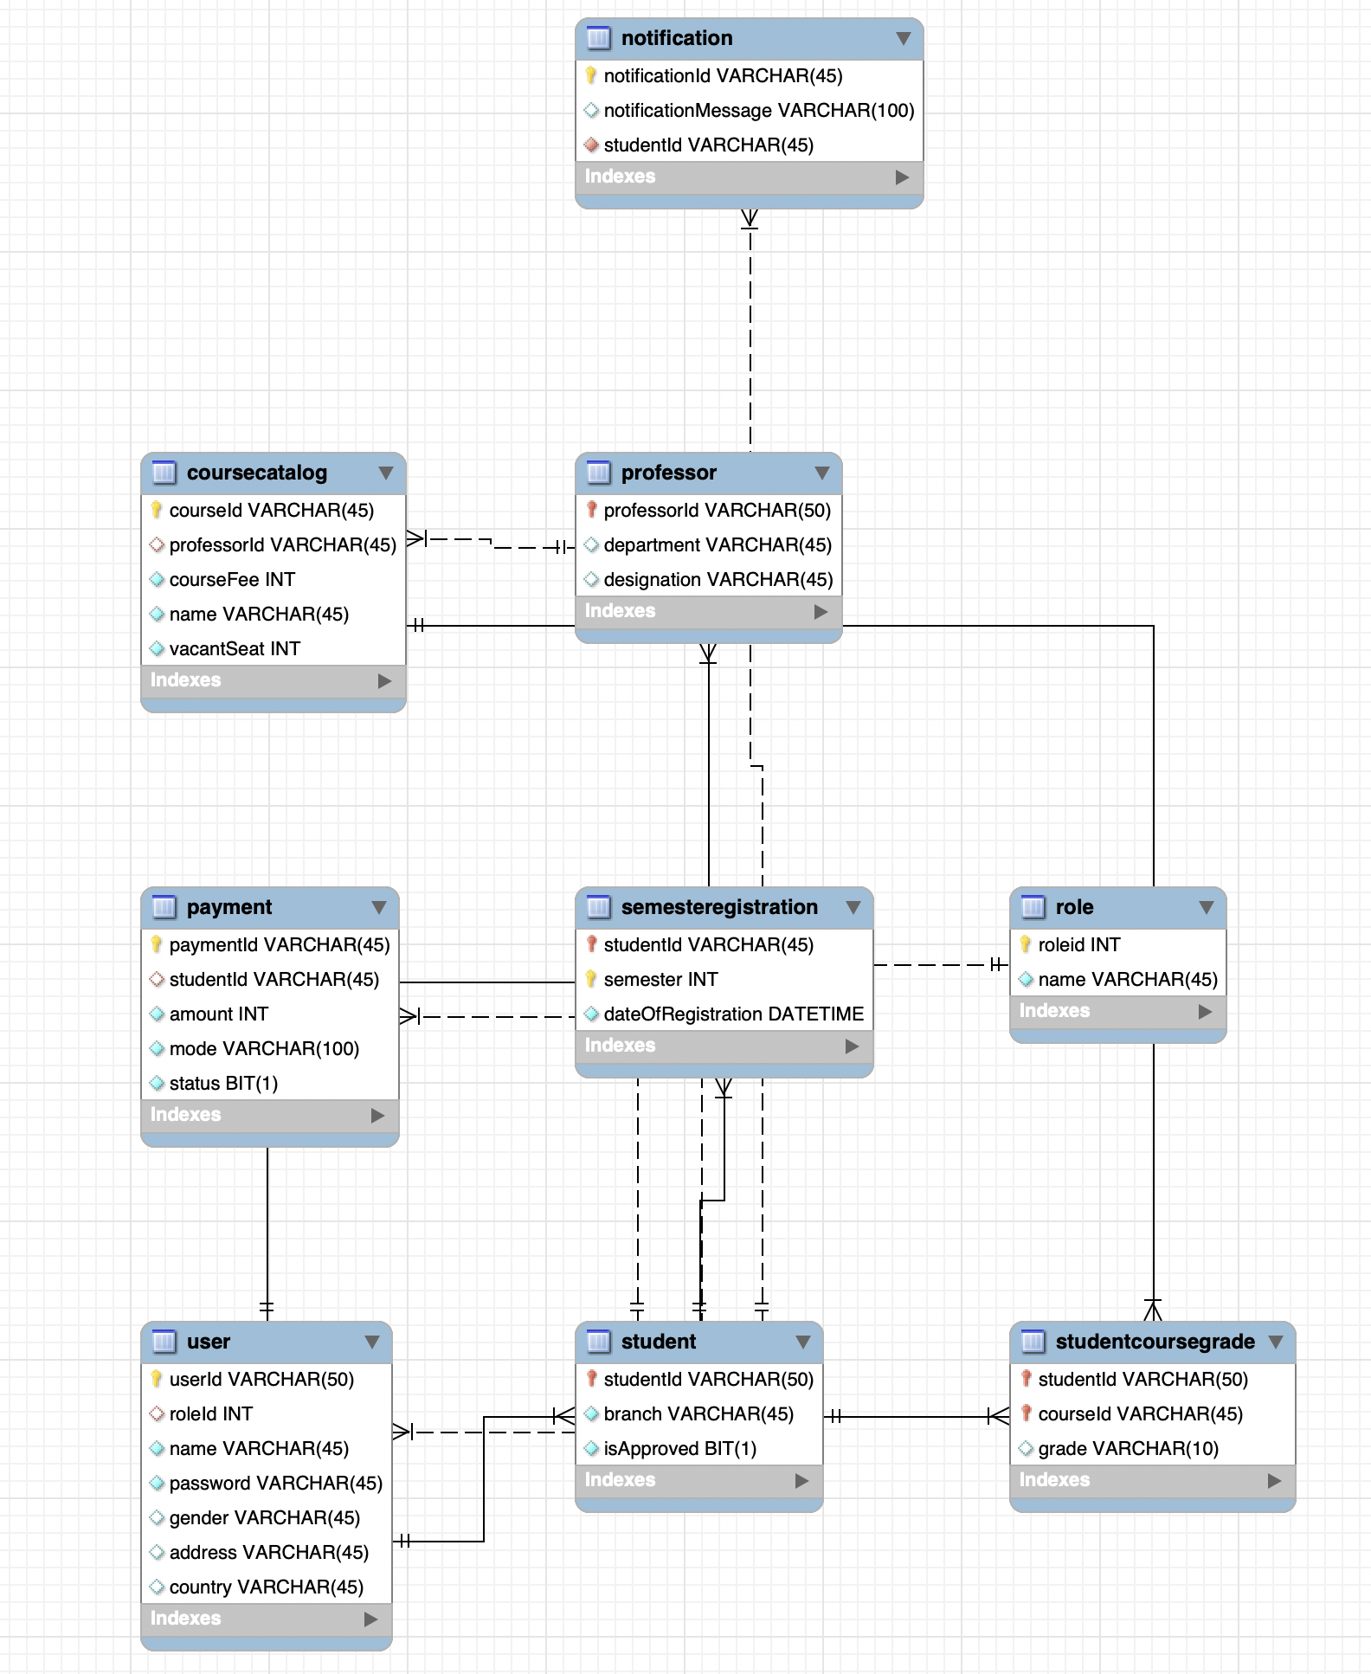
DATABASE SCHEMA

Slide 30

Demo
Notes:
Time –
Architecture – 5 mins
NFR Dashboard – 3 mins
Demo – 10 mins
1. Show the Responsiveness and Wave tool first

Slide 31

Questions
Notes:
Time - ?

Slide 32
Thank you :)
Notes:
Time – After this show the testimonial video. 1 min

